Slide 1

CASE FILE: THE FORGETTABLES
Status: Open
Classification: Discreet Operations Unit.
Five legendary assassins, now retired and forgotten, live quietly in Dudley and reluctantly return to work while navigating ordinary British life.

Slide 2
When systems fail, the Forgettables don’t fix the problem — they conclude it…

Slide 3
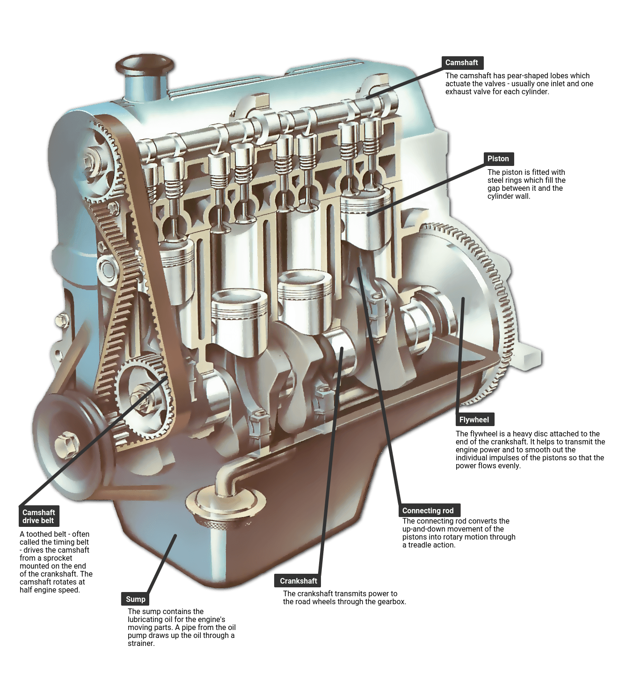
HOW THE SHOW WORKS
Each episode follows a clear structure.
Teaser — a crime occurs.
Identification — Dennis logs it.
Assembly — the team gathers at the Broken Badger pub.
Planning — Dennis outlines the operation.
Execution — They quietly perform the correction.
Aftermath — the police investigate.
Closure — Dennis stamps the file CONCLUDED.
Everything is treated as entirely routine.
And, the world never knows the Forgettables were there.

Slide 4
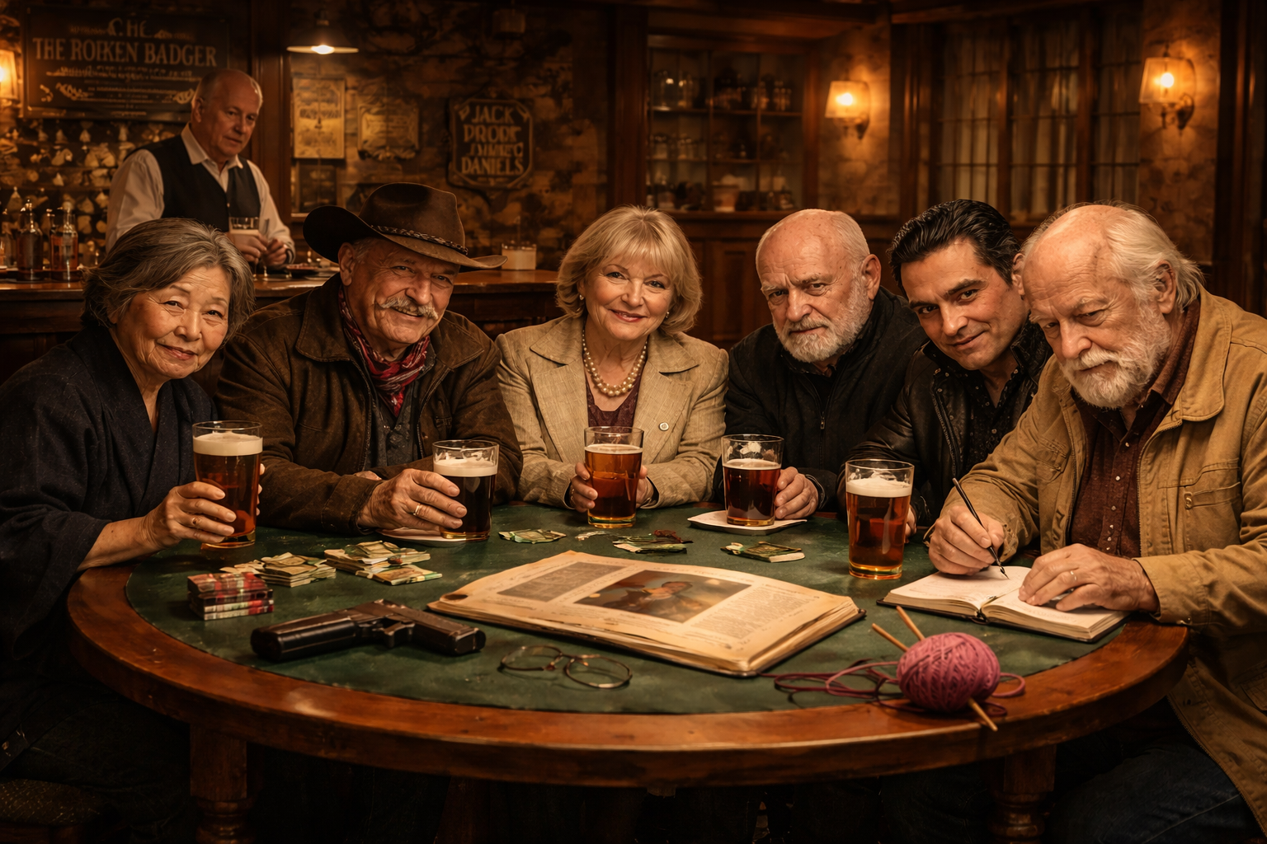
The Forgettables HQ
INT. BROKEN BADGER – NIGHT
Six people sit around a table.
Pints. Pie. Silence.
Dennis opens a folder.
“Right. Let’s begin.”

Slide 5
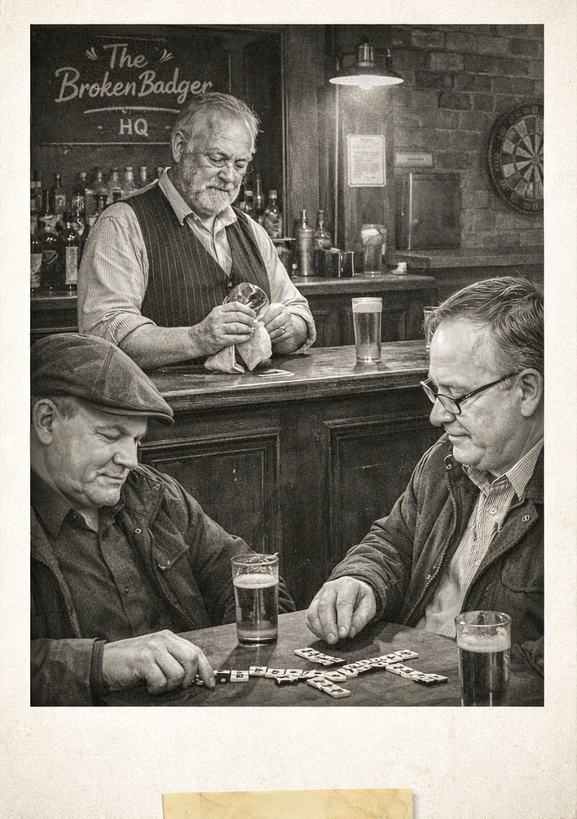
Landlord: Monty
Runs the pub with the steady indifference of a man who has seen every kind of customer imaginable.
Serves stout and pie and only stout and pie.
Does not ask questions.
Has concluded that whatever The Forgettables are doing is:
None of his business.
Probably beneficial to the community.
Regulars: Jack and Daniels
Drink stout. Eat pie. Nothing else.
Play dominoes.
Theorise on The Forgettables activities.
Known Aliases:
Gin & Tonic, Statler & Waldorf, Randolph & Mortimer, Salt and Pepper and many others.
Monty, Jack & Daniels

Slide 6

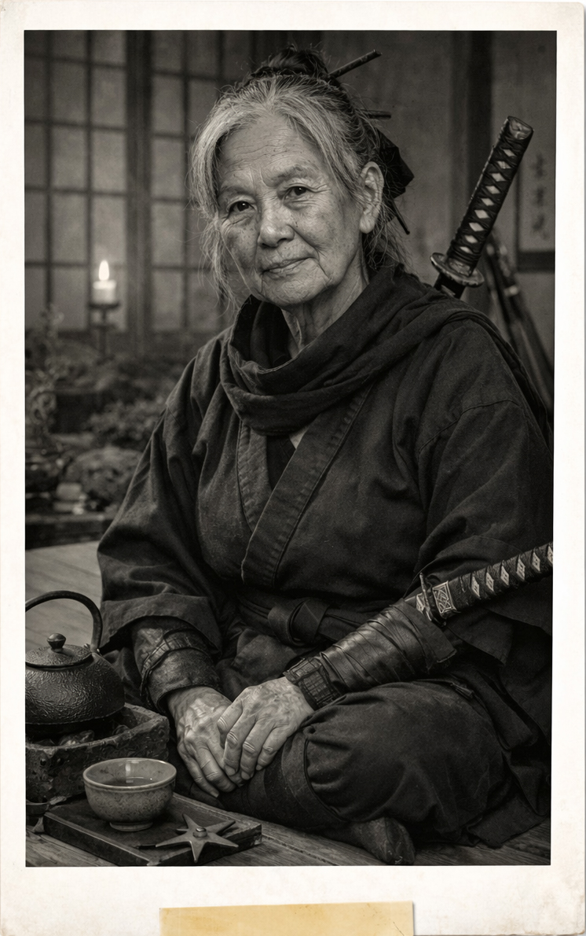
Silent Elimination Specialist
A master of stealth who treats violence as a form of balance.
Nationality: Japanese (unconfirmed).
Known Aliases
The Quiet Step.
Kage no Hana (“Shadow Flower”).
Mrs Tanaka (Dudley GP surgery records).
Specialities
Stealth infiltration.
Silent termination.
Close-quarters combat.
Disguise and concealment.
Urban rooftop movement.
Preferred Weapons
Carbon-steel tanto knife, Improvised weapons (household objects, tools, stationery).
Akiko Tanaka

Slide 7
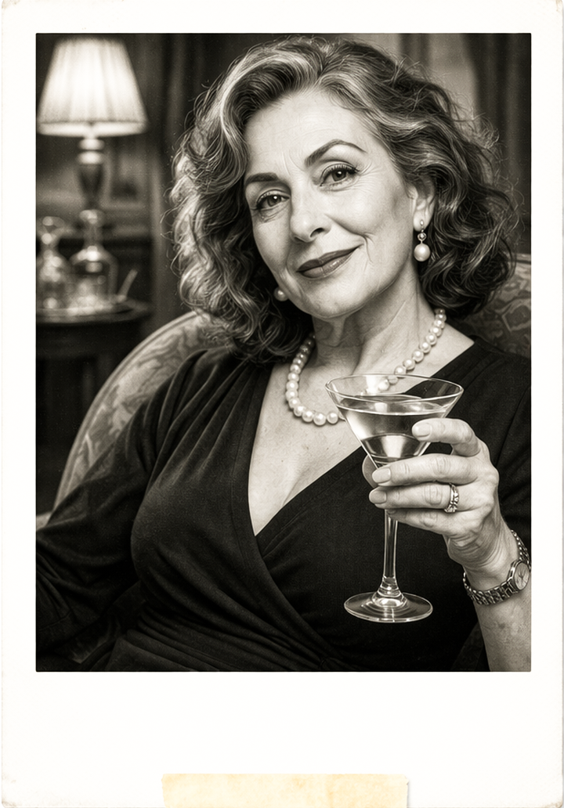
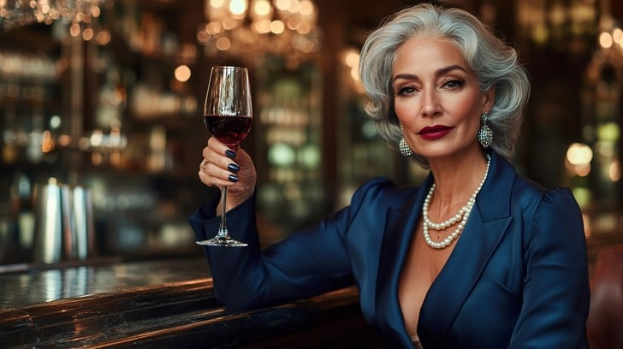
Social Infiltration Specialist
A charming intelligence asset capable of persuading almost anyone to do almost anything. Almost.
Nationality: varies depending on operational requirements.
Known Aliases
La Veuve Rouge (“The Red Widow”), Madame Orchidée. [REDACTED].
Specialities
Seduction and social manipulation.
Information extraction.
High-society infiltration.
Preferred Termination Methods
Poisoned drink.
Slow-acting toxins.
“Medical complications” following intimate encounters.
Preferred Weapon
Ring-mounted micro-needle containing neurotoxin.
ISABELLA MOREAU

Slide 8
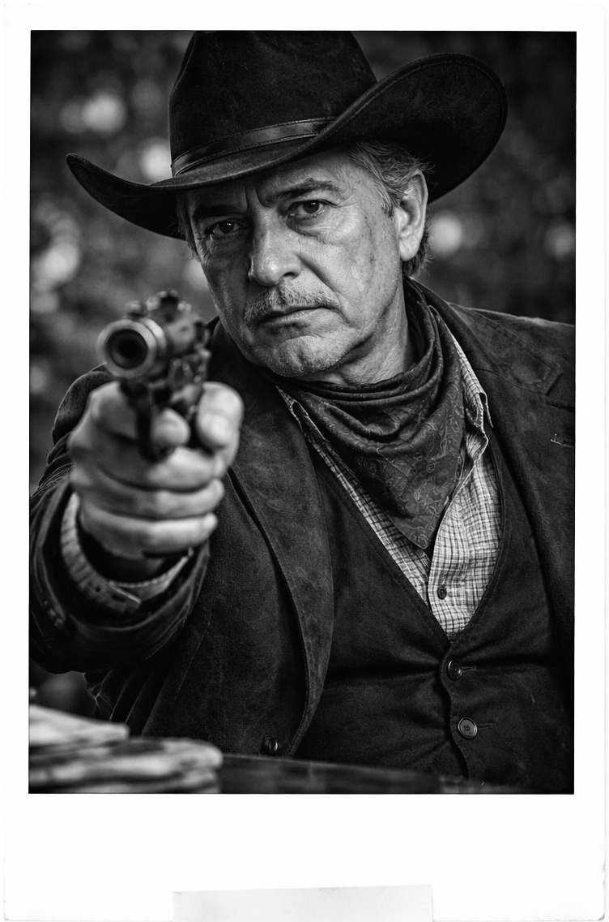

Self-Styled Gunslinger
A retired cartel enforcer who believes every operation should resemble a Western.
Nationality: Spanish, Mexican. Much debated.
Known Aliases
El Fantasma del Norte.
The Man of Twelve Paces.
El Vaquero.
Specialities
Revolver combat.
Close-range ambush.
Dramatic entrances.
Preferred Termination Methods
Revolver duel.
Close-range ambush.
Hobbies
Model railway building.
Watching The Cisco Kid and Western films.
Practising gun draws in empty car parks.
MARIO GONZALEZ DA SILVA

Slide 9

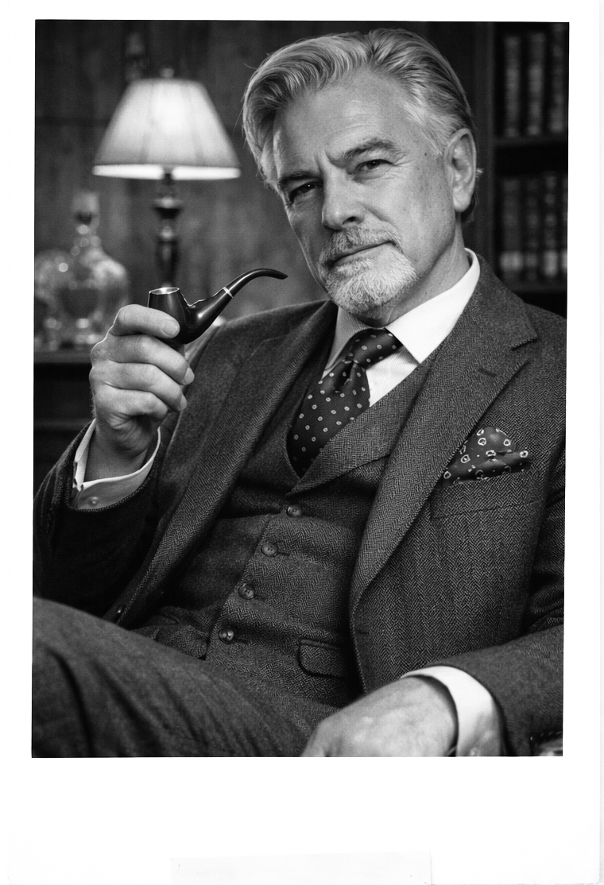
Former Special Projects Officer
A bureaucratic assassin who believes the most powerful weapon in the modern world is administrative authority.
Nationality: British.
Previous Profession
Senior Operations Officer, Special Projects Division (government classification).
Specialities
Strategic planning.
Diplomatic “problem resolution”.
Covert elimination.
Preferred Termination Methods
Precision rifle.
Engineered accidents.
Administrative disappearance.
Preferred Weapon
Suppressed Walther PPK.
Also maintains an extensive poison kit.
CLIVE PEMBROKE-SMYTHE

Slide 10
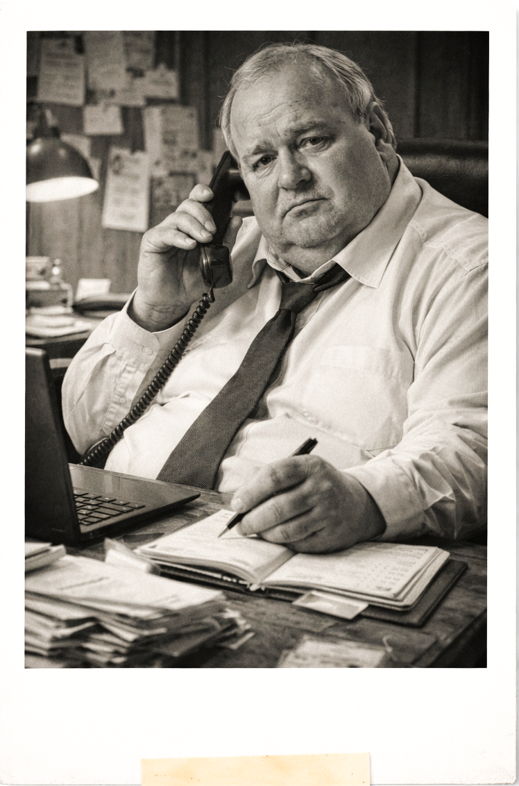

Operations Coordinator
The administrative mastermind behind the operation.
Runs murder like a spreadsheet.
Nationality: Unknown.
Aliases: Unknown.
Previous Profession: Quantity Surveyor, allegedly.
Specialities
Target identification.
Operational logistics.
Case documentation.
Strategic scheduling.
Known Habits.
Maintains a chronometer during all operations.
Records every case in a personal notebook.
Prefers structured planning to improvisation.
(Just) DENNIS

Slide 11

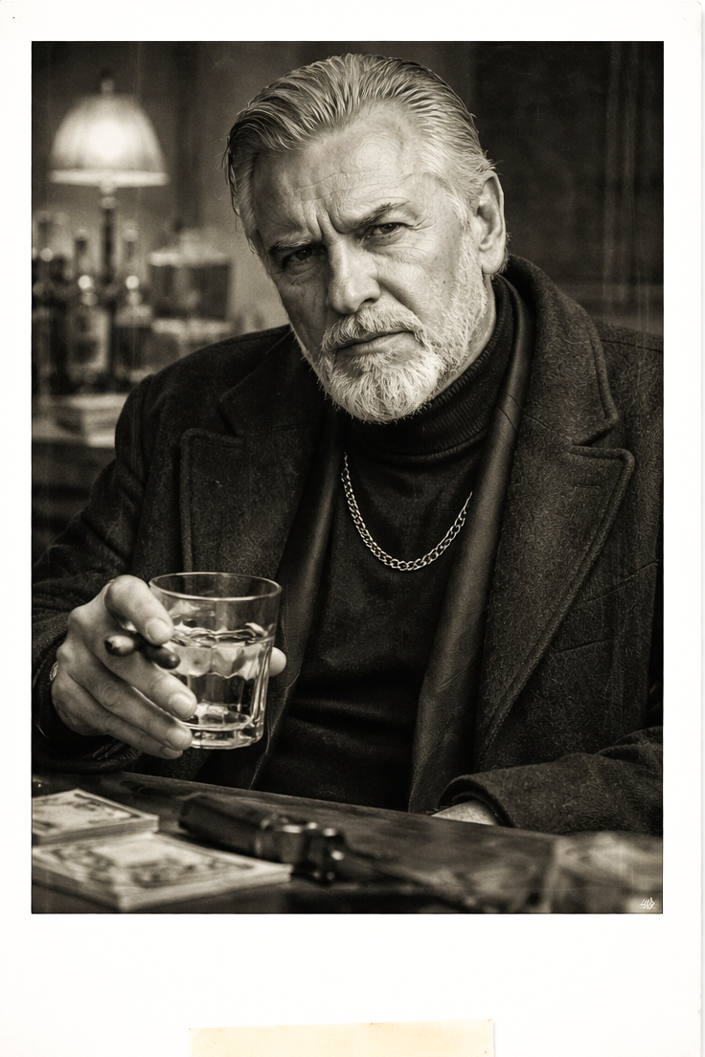

Former Directorate S Enforcer
A Cold War eliminator who believes every problem has a direct solution.
Nationality: Russian / Former Soviet Union (widely debated
Known Aliases
The Volga Ghost.
Comrade Silence.
“Mr Alexander” (Dudley Neighbourhood Watch WhatsApp group).
Specialities
Close-quarters elimination.
Physical intimidation.
Tactical surveillance.
Perimeter control.
Preferred Termination Methods
Blunt force trauma, manual cervical dislocation.
Hobbies
Walking his pet Pomeranian, Rasputin, Neighbourhood Watch meetings.
ALEXANDER DIMITRIOV

Slide 12
Status: ACTIVE
Further interventions anticipated…
A clean, repeatable, character-led dark comedy with a strong tonal identity and a castable ensemble.

Slide 13
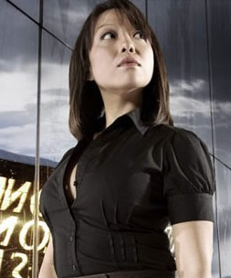
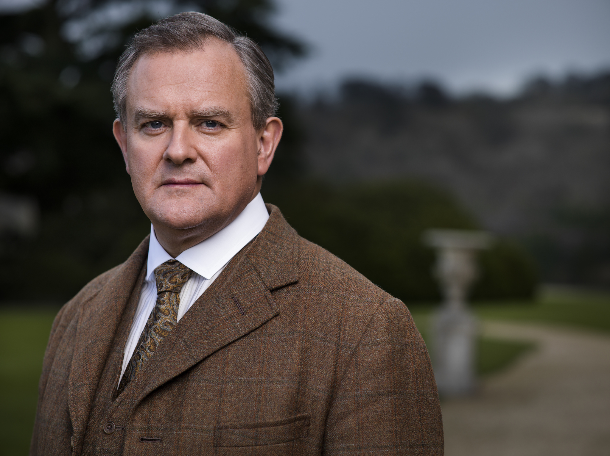
AKIKO TANAKA
A former covert operative who now runs a quiet yoga studio in Dudley.
Still. Observant. Exact.
When she moves, it’s already over.
Casting Suggestion: Naoko Mori
Brings precision, intelligence, and quiet authority —
capable of shifting from warmth to lethal efficiency without spectacle.
CLIVE PEMBROKE-SMYTHE
A former intelligence operative who now treats assassination as a matter of process, protocol, and correct documentation.
Measured. Polite. Unavoidable.
Casting Suggestion: Hugh Bonneville
Brings institutional authority, warmth, and quiet menace — capable of making devastating outcomes feel like administrative inevitabilities.

Slide 14
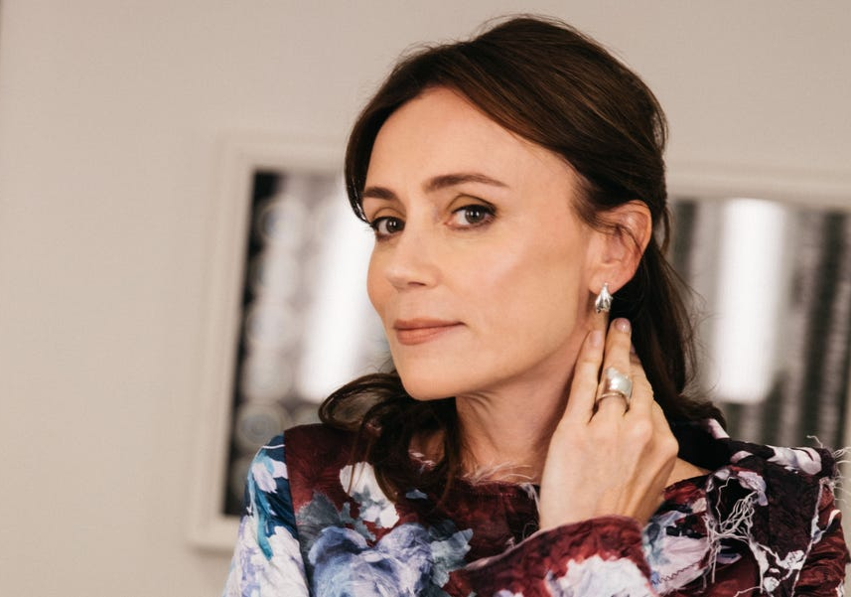
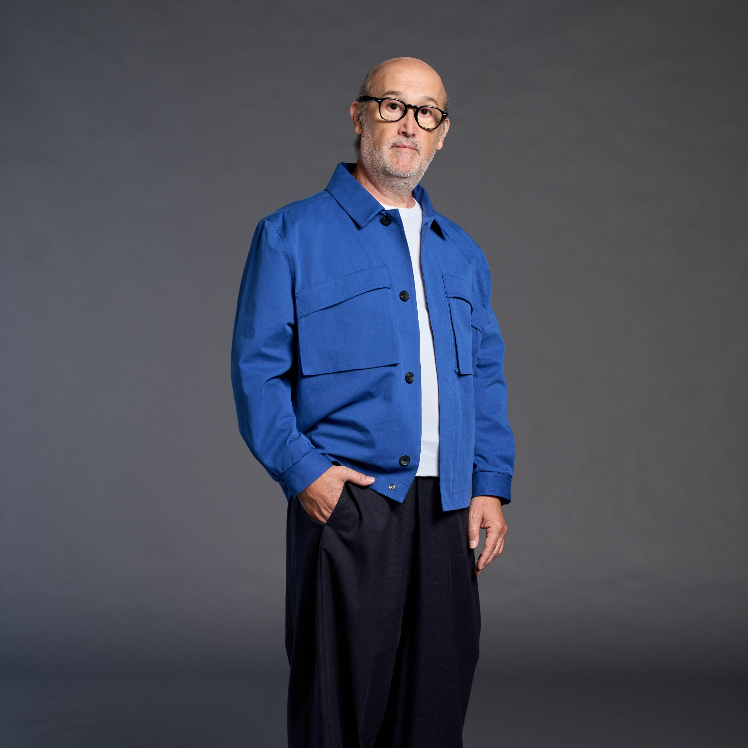
ISABELLA MOREAU
A former high-society operative who now navigates rooms, conversations, and outcomes with effortless control.
Warm. Observant. Already ahead of you.
Casting Suggestion: Keeley Hawes
Brings intelligence, poise, and quiet authority — capable of turning everyday interaction into something quietly dangerous.
MARIO GONZALEZ DA SILVA
A former gunslinger who now fills his days with routines, small comforts, and stories that may have improved with time.
Warm. Opinionated. Occasionally brilliant.
Casting Suggestion: Javier Cámara
Brings humour, humanity, and lived-in authenticity — a man who feels entirely ordinary until he isn’t.

Slide 15
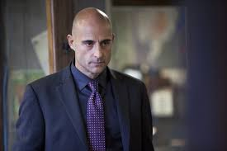
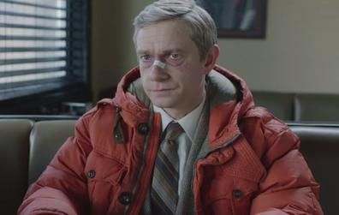
ALEXANDER DIMITRIOV
A former intelligence operative who never quite retired — only redirected his attention to smaller, more local concerns.
Watchful. Methodical. Unnecessarily thorough.
Casting Suggestion: Mark Strong
Brings controlled intensity and credibility — a man who treats even the smallest problem as a matter requiring professional resolution.
DENNIS
A former quantity surveyor who now coordinates a group of retired assassins with the same quiet efficiency he once applied to budgets, timelines, and risk assessments.
Practical. Observant. Relentlessly organised.
Casting Suggestion: Martin Freeman
Brings intelligence, restraint, and dry humour — the calm centre of a system that should not function, but somehow does.

